Slide 1


Reading at home
Supporting your child in learning to read

Slide 2
Using the reading journals
‘Please avoid saying ‘This book is too easy for you!’.
Instead say: ‘I love how well you can read this book!’ They are meant to be able to read all of the words in the book as it is at the correct level.’
Notes:
Positivity. Show your child how pleased you are that they can read the book. We need the children to think that they are readers. This will build up confidence and knowledge and help them to be successful, reading more and more books.
If you think you can, you can.

Slide 3
In your child’s bookbag, they will bring home:
• The storybook ‘Learning to Read Book’ they have read in class to practise reading what they can already read
• Another book ‘Reading for Pleasure Book’ closely matched to your child’s reading ability so they can practise sounds and words they have learnt over time
• A library book, or a picture book to share and enjoy together
• Your child will also be bringing home ‘Speed Sound Practice Sheets’ each time they learn a new sound in their phonics lesson.
If you would like further support and resources, please visit:
https://home.oxfordowl.co.uk/reading/reading-schemes-oxford-levels/read-write-inc-phonics-guide/

Slide 4
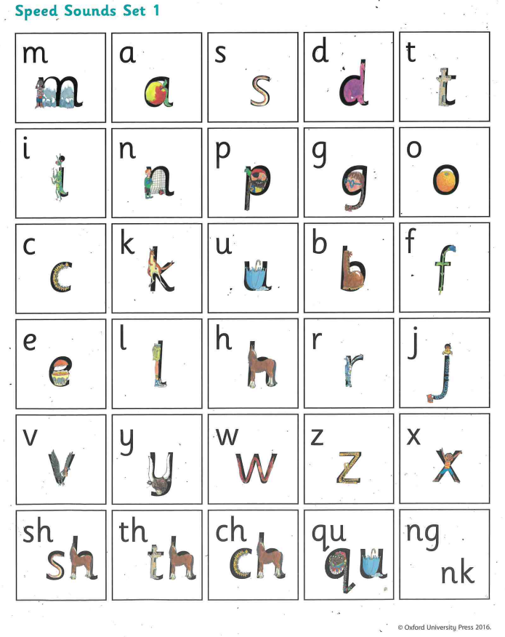
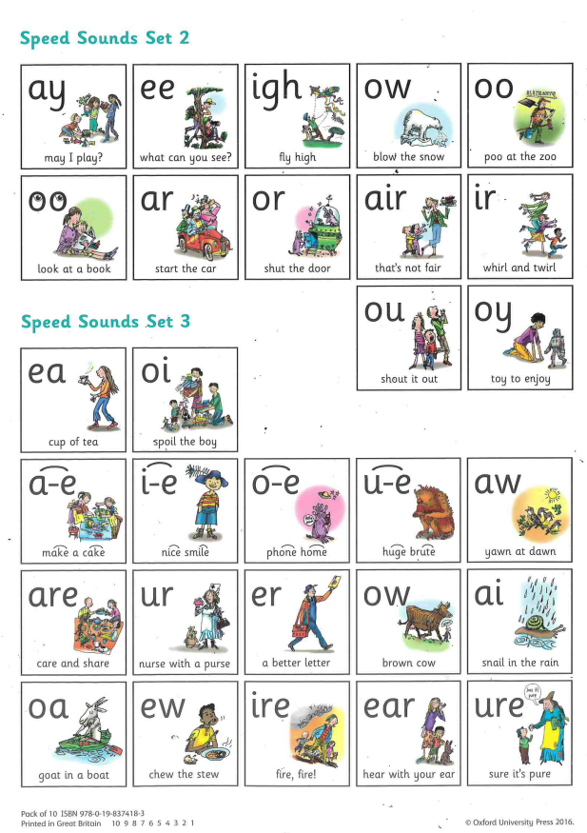
Notes:
These are a great reference for you when helping your child read and when they are trying to spell words as well for other home learning activities. They have access to these in class so are familiar with them.

Slide 5
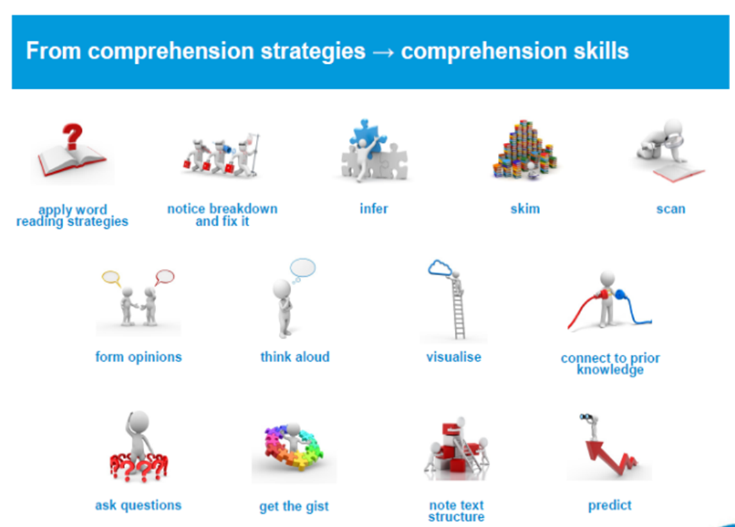
Notes:
Once your child is fluent with a book and can ‘word-read’ it, we now want them to read it to aid their understanding of it.
Good readers ask questions all of the time.
We need to teach our children to think
This reading record has many examples of questions you can ask your child when you are sharing a book, but there will also be other questions in the Read Write Inc books your child will be bringing home to share with you.
like readers so that they can learn from what they read.

Slide 6
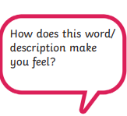

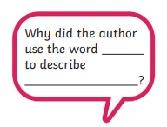

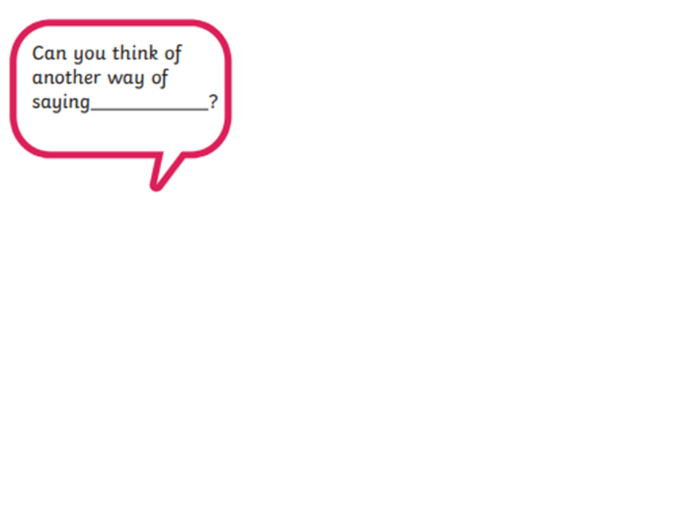
Comprehension Domains
Where is the word that means?
Who spoke to…?
What happened after?

Slide 7
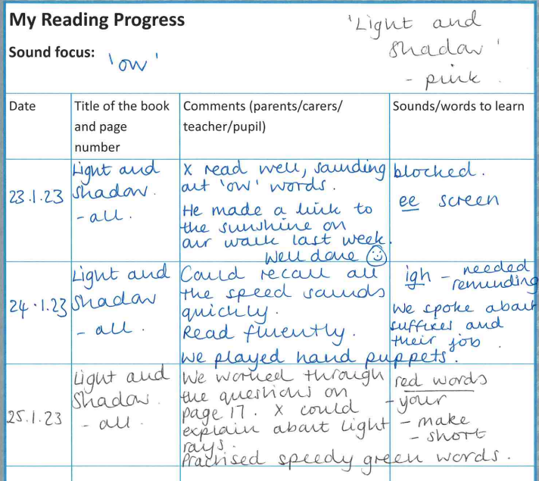
Recording your child’s reading
Notes:
This helps us to make a really accurate assessment of where your child is at with their reading journey.

Slide 8
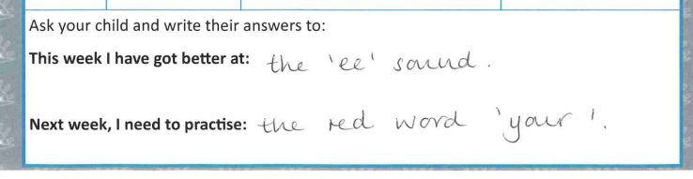
Recording your child’s reading
Notes:
This helps us to make a really accurate assessment of where your child is at with their reading journey.

